Slide 1
Overview of Global Land Data Assimilation (GLDAS) Runoff Data
John Eylander
Nov 17, 2022
Notes:
National Aeronautics and Space Administration

Slide 2
Learning Objectives
Describe Global Land Data Assimilation System (GLDAS)
Access GLDAS Runoff Data

Slide 3
What is a Global Land Data Assimilation System?
Aggregates multiple types of data together in order to initialize a land surface model (LSM) or surface hydrology model
Weather and hydrologic “forcings” – data used as input to LSMs
Terrain and land use information (elevation, slope, vegetation, soils)
Weather data (precipitation, cloud cover, temperature, humidity, winds, snow cover and depth)
Newer GLDAS systems have data assimilation algorithms enabling the blending of satellite observations of land parameters into the model estimates (e.g. soil moisture, snow, vegetation health)
GLDAS systems often are used to initialize weather and climate models

Slide 4
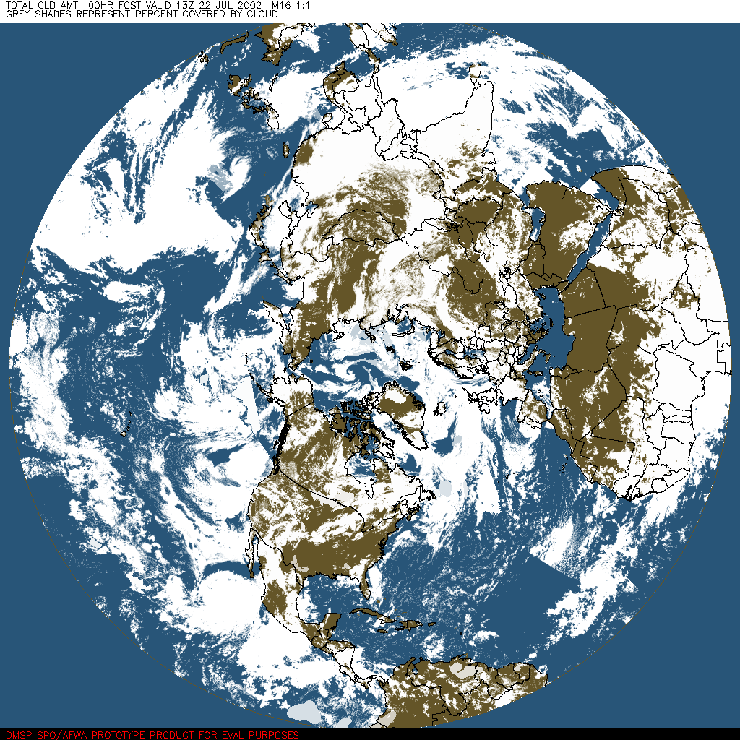
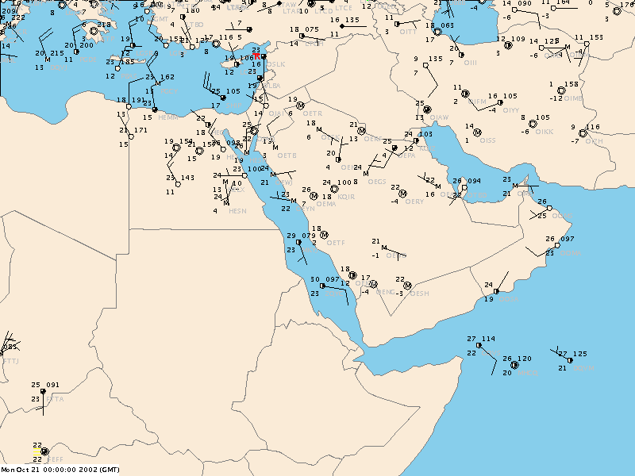
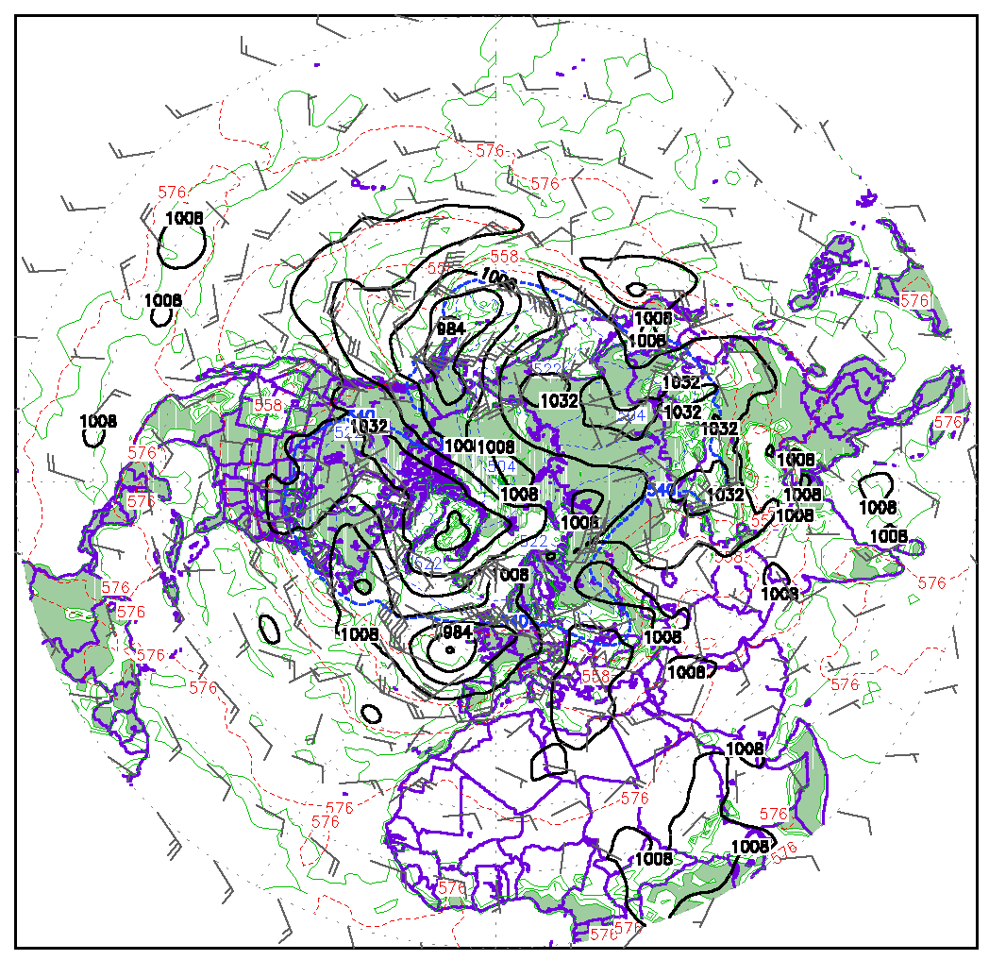
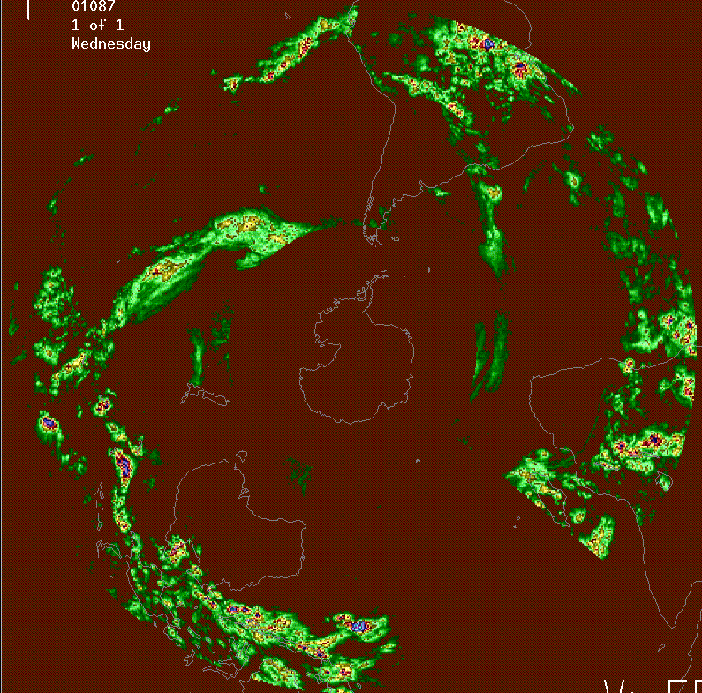
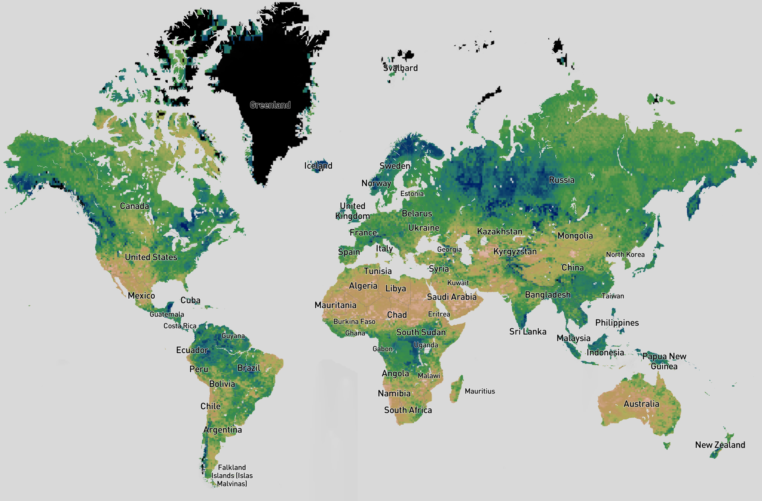
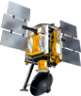
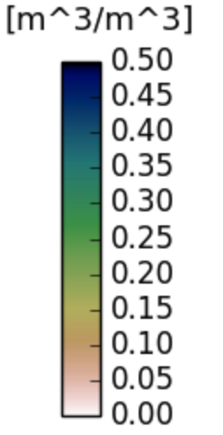
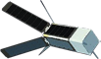
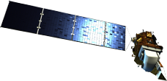
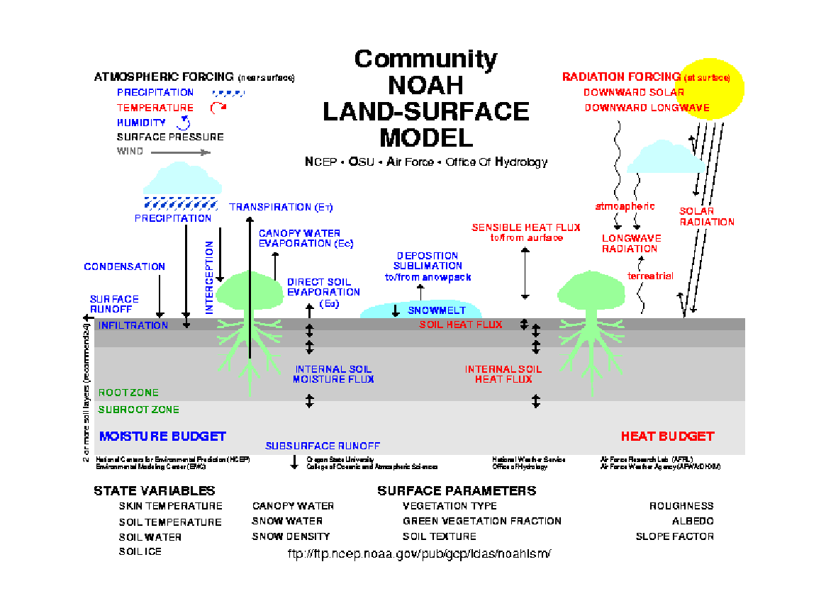
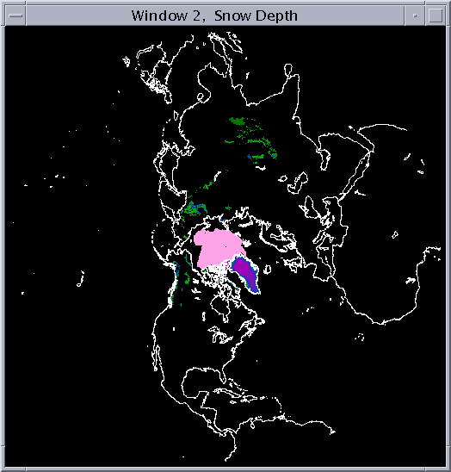
Global Land Data Assimilation Systems
Land Data Assimilation System (LDAS) merges data from multiple sources to compute soil water mass and energy estimates useful for weather and climate forecasting, military applications
Global Cloud Cover Analysis
precipitation & snow observations & analyses
Weather (T, RH, Winds)
Satellite observations of soil moisture, temperature
Land surface model
NWP first guess combined
with obs of T, u, v, RH
to derive shelter analysis
①
Surface gauge & satellite,
(GEO & LEO) merged to
derive precip, snow analysis
cloud analysis
used to derive
surface radiation analysis
Shelter Analysis
Radiation
Analysis
②
Precipitation
Analysis
③
Results
Satellite Soil Moisture, Temp. & Snow
4
5

Slide 5
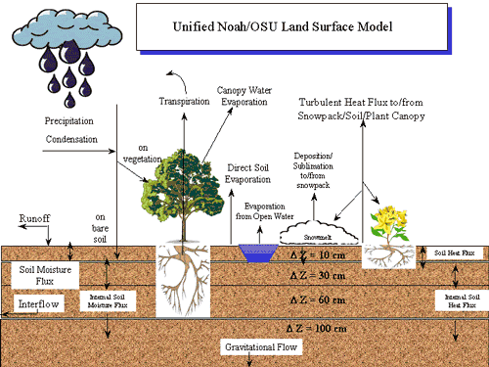
What is a Land Surface Model (LSM)?
Unified Noah LSM diagram (Chen and Dudia 2001)
In contrast to surface hydrology models that aim to represent runoff/streamflow, land surface models analyze soil-water and soil-temperature relationships to estimate land-atmosphere energy exchange
LSMs are usually “coupled” to an atmospheric weather or climate prediction (or analysis) model
LSMs usually run gridded (a.k.a distributed) for large regions versus lumped hydrology models which aim to evaluate small watersheds

Slide 6
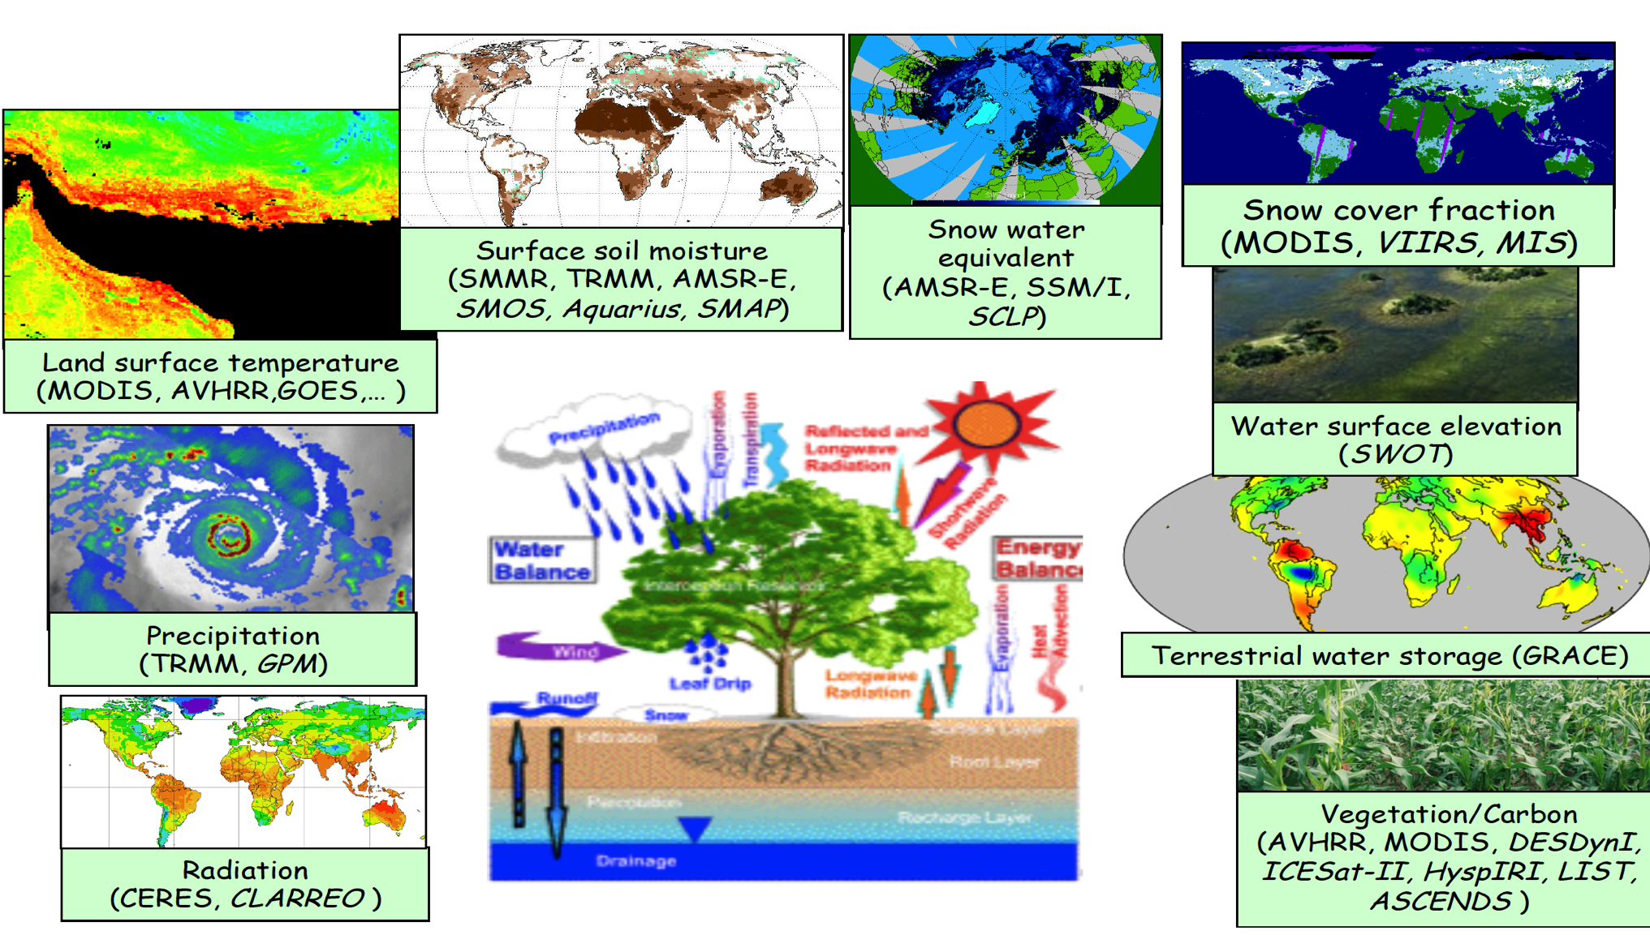
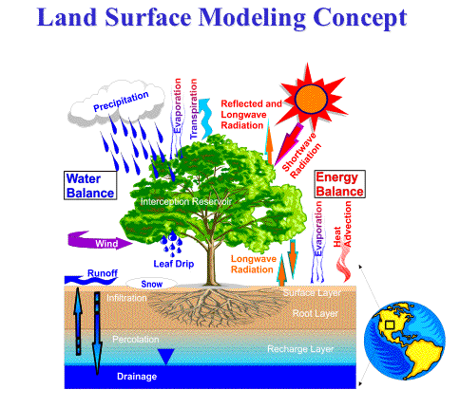
Satellite Data Assimilation with GLDAS
Multiple types of satellite observation data have been added to GLDAS via assimilation
Soil moisture
Soil temperature
Precipitation
Snow cover, depth, and water content
Groundwater (GRACE)
Land Surface Modeling, Uncertainty Estimation, Data Assimilation, and Evaluation Concept

Slide 7
Global Land Data Assimilation Systems
GLDAS systems are often executed in real-time to support weather forecasting, and retrospectively to support climate analyses and climate forecasting
E.g. can be used to create a 30-year climatology of gridded products for climate analysis (often called a land reanalysis – ERA5, MERRA-Land, etc.)
GLDAS systems are often executed on large high performance computing systems because of the large amount of data used and complexity of the land models, especially for climate runs

Slide 8
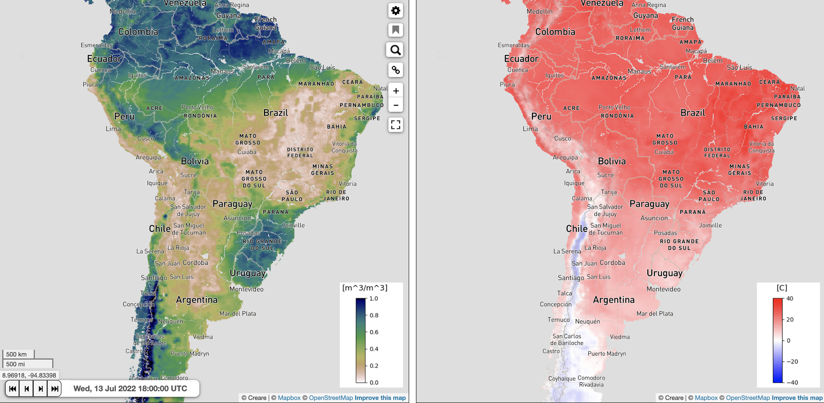
Example GLDAS Products
0-10 cm Volumetric Soil Moisture (m³/m³)
0-10 cm Soil Temperature (m³/m³)

Slide 9
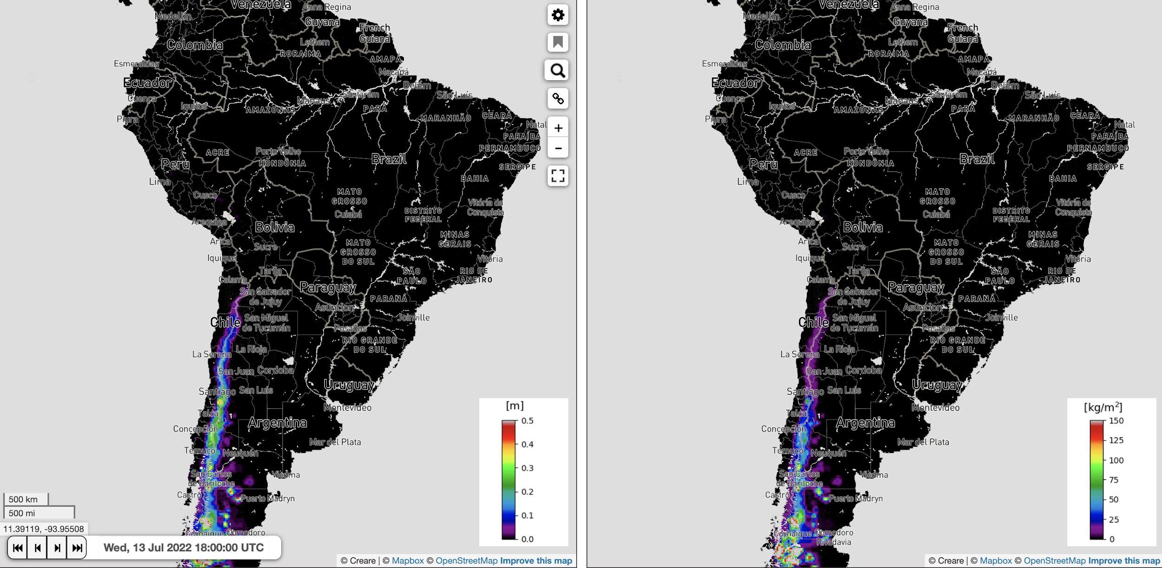
Example GLDAS Products
Snow Depth (m)
Snow Water Equivalent (kg/m²)

Slide 10
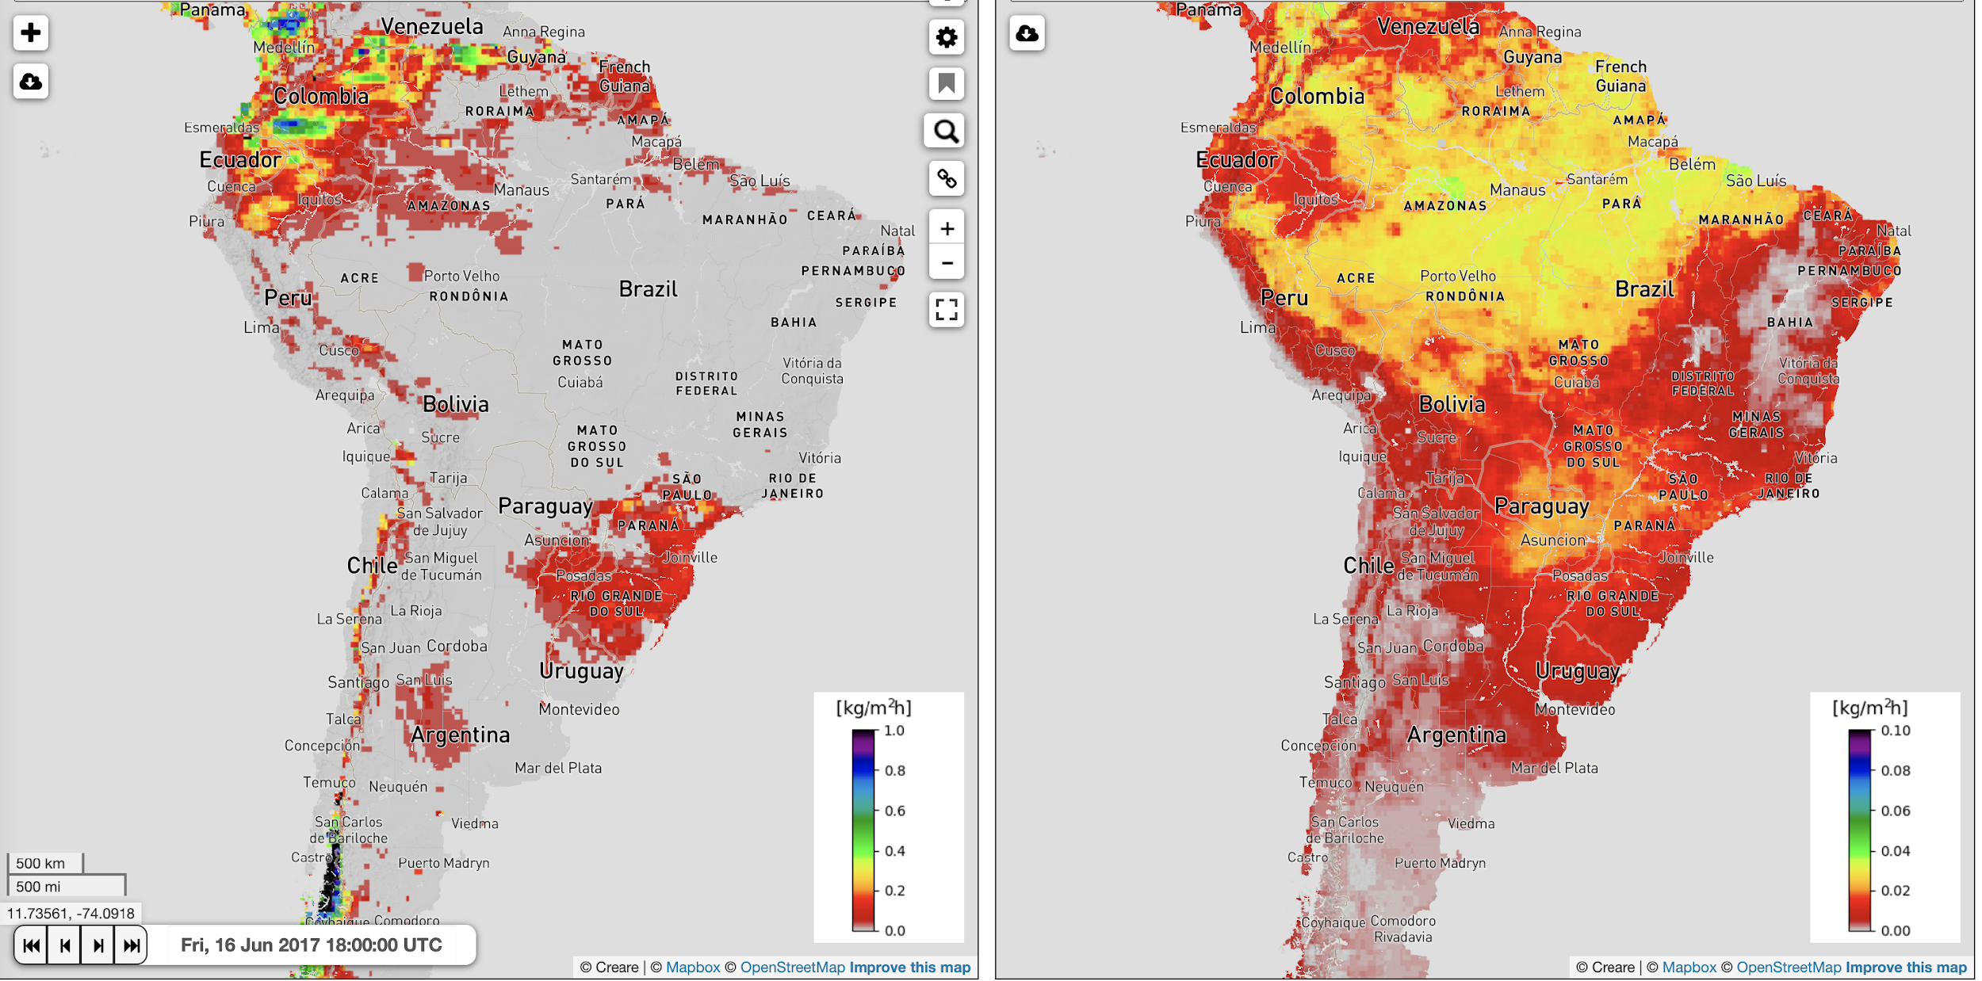
Example GLDAS Products
Surface Runoff (kg/m² hr)
Evapotranspiration (kg/m² hr)

Slide 11
Links to obtain GLDAS output from NASA Giovanni server

Slide 12
GLDAS Data Access
Model | Spatial/Temporal Resolution | Data Source
GLDAS (NOAH) | 1/4th – 1 degree (global) 3 hour, monthly 1948-2010 | Giovanni http://giovanni.gsfc.nasa.gov/giovanni
NOAH (v2.1) | 2000 - present
VIC | 1979 - present
Original data files are in GRIB format

Slide 13
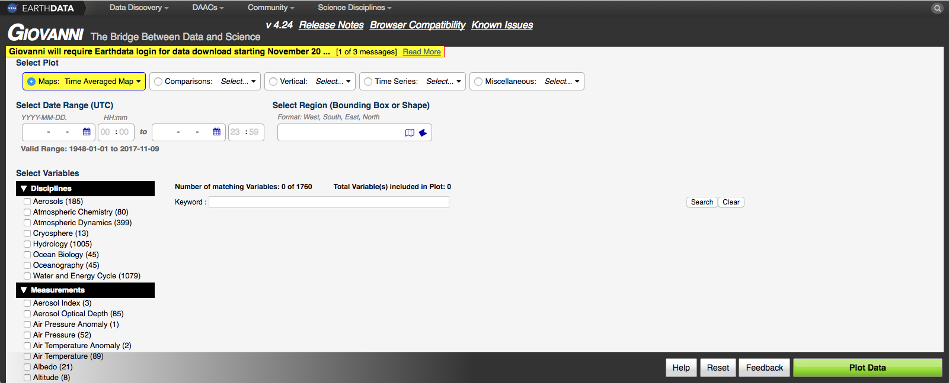
Search, Select, and Download Runoff Data from Giovanni
http://giovanni.gsfc.nasa.gov/giovanni/
Analysis & Plot Options
Temporal & Spatial Search
Map & shapefile selection countries & U.S. states
Search data by keyword
Plot Data

Slide 14
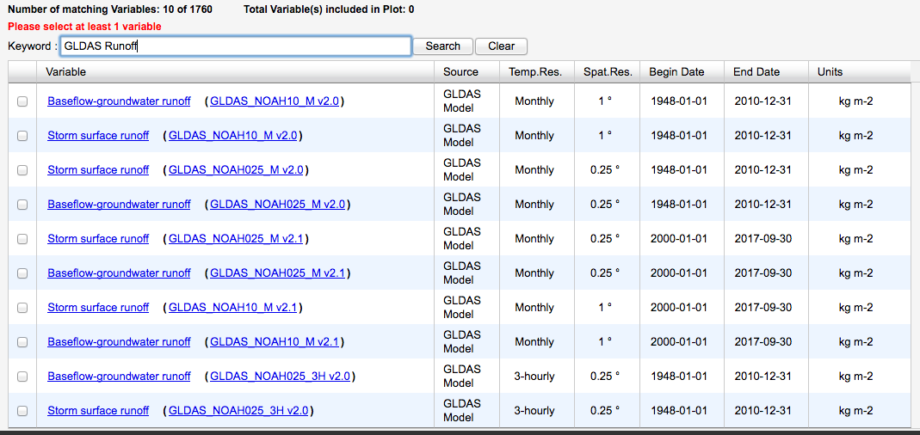
Runoff Data
Available form GLDAS Noah v2.1
Storm surface runoff is available at monthly and hourly time scales, at 0.25° and 1° resolution

Slide 15
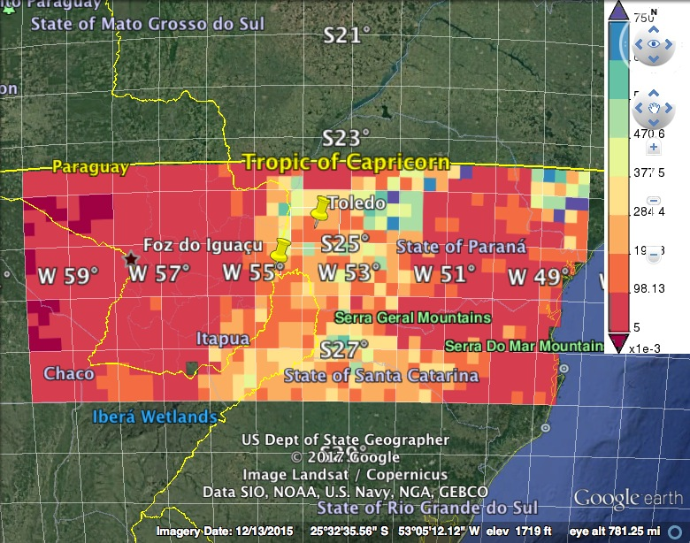
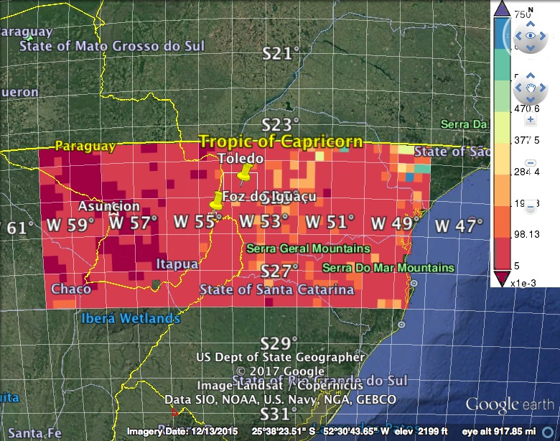
Runoff Over Parana
DJF 2016
DJF 2017

